Slide 1
Property Rights and Investment Incentives: Theory and Evidence from Ghana
Tim Besley
QJE, 1995

Slide 2
Objectives
Examine effects of property rights on investment
But recognizing the endogeneity of property rights
Does this in the context of Ghana where rights are in transition from traditional community control to individual rights

Slide 3
Two Regions
Wassa: Cocoa-growing . Investment decision is to plant trees. Most land owned with rights but still subject to tribal authorities
Anloga : Shallot (small onion) , much land not owner operated. Investments in land improvements (drainage, fertilizers, irrigation). Higher pop. Density with agriculture less dominant here. Inheritance of land very common, less need for approval by tribal authorities
Land rights are hard to codify . De Jure and de facto may differ substantially. A detailed questionnaire is used to get to the extent to which various rights are individual as opposed to being under community control

Slide 4
Model
K_{ijt} = f(R_{ijt+1}, z_{it}, x_{ijt}) Investment Equation
y_{ijk} = α_{k}z_{i} + β_{k} R_{ij} +γ_{k} x_{ij} +e_{ijk} for each different type of investment k in discrete form 0,1
R_{ijt+1} = g(K_{ijt} , z_{it}, x_{ijt,} R_{ijt}) Property Rights Equation
Hence Rights could well be endogenous depending on investments in land
Empirical Version takes advantage of detailed information in questionnaire about property rights de facto, R, plot characteristics, x, and hh characteristics, z and hh fixed effects since the same household may hold multiple plots with different property rights. Rights appear both as exogenous in OLS estimates of Investment as is and as instrumented by R equation.
With use of linear probability model (instead of probit, logit) can estimate fixed effects. Alternative is to instead include many hh-specific characteristics that are measured.

Slide 5
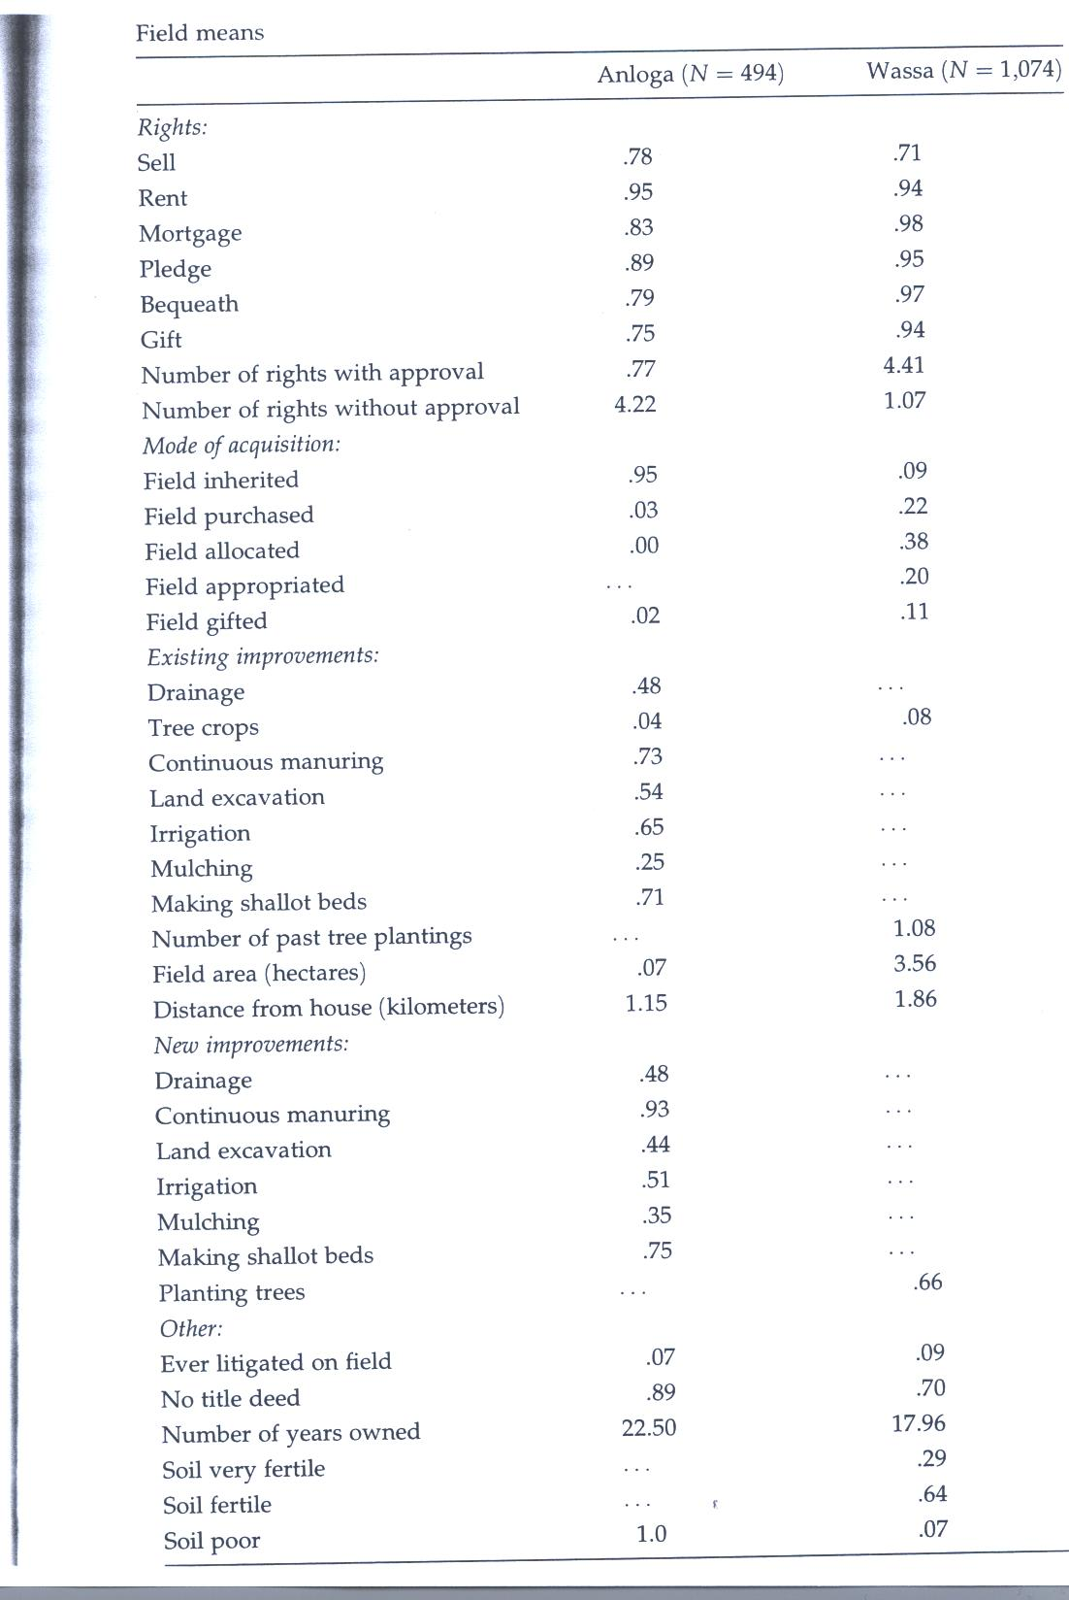

Slide 6
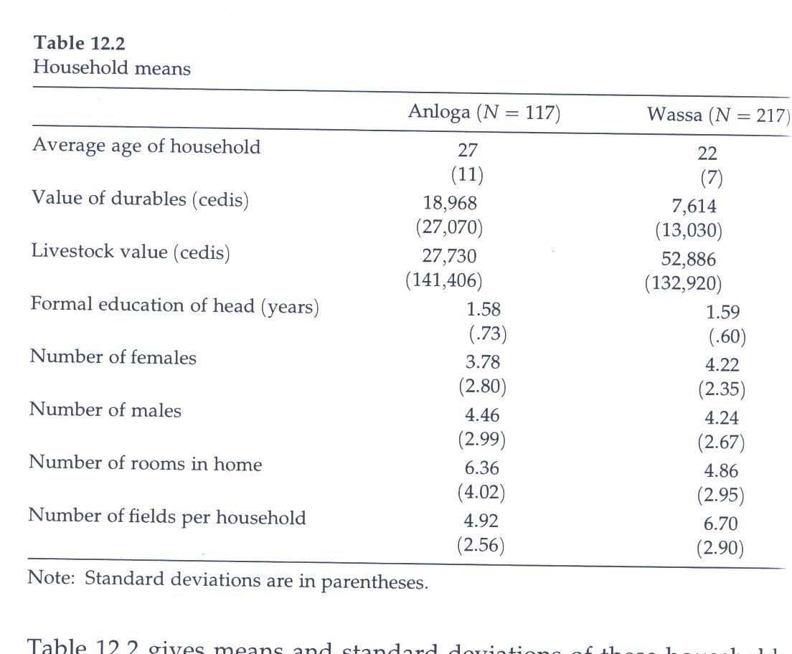

Slide 7
Alternative Sets of Estimates with Aggregate Rights Measures
Table 12.3 for Wassa with and w/o instruments and including the 1st stage regressions with many observable hh and plot characteristics
12.4 for Wassa with hh dummy variables
12.5 Investments for Anloga
12.6 Rights regressions for Anloga
12.7 Investments for Anloga

Slide 8
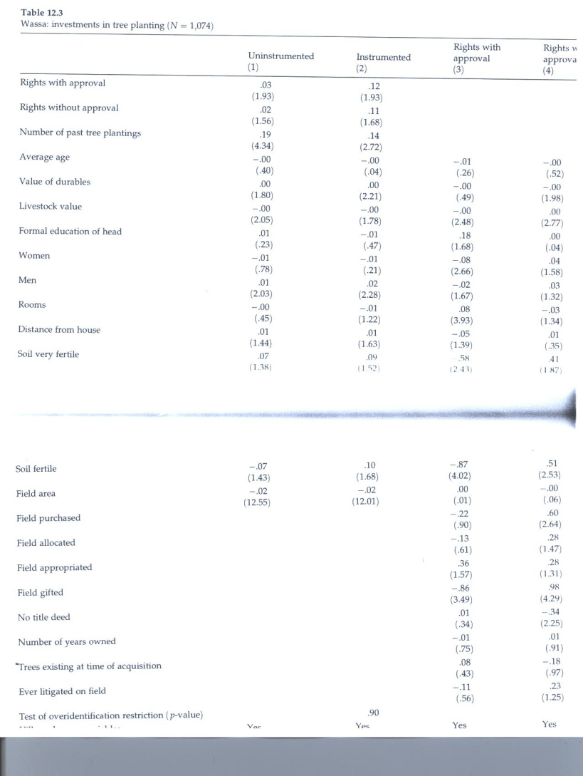

Slide 9
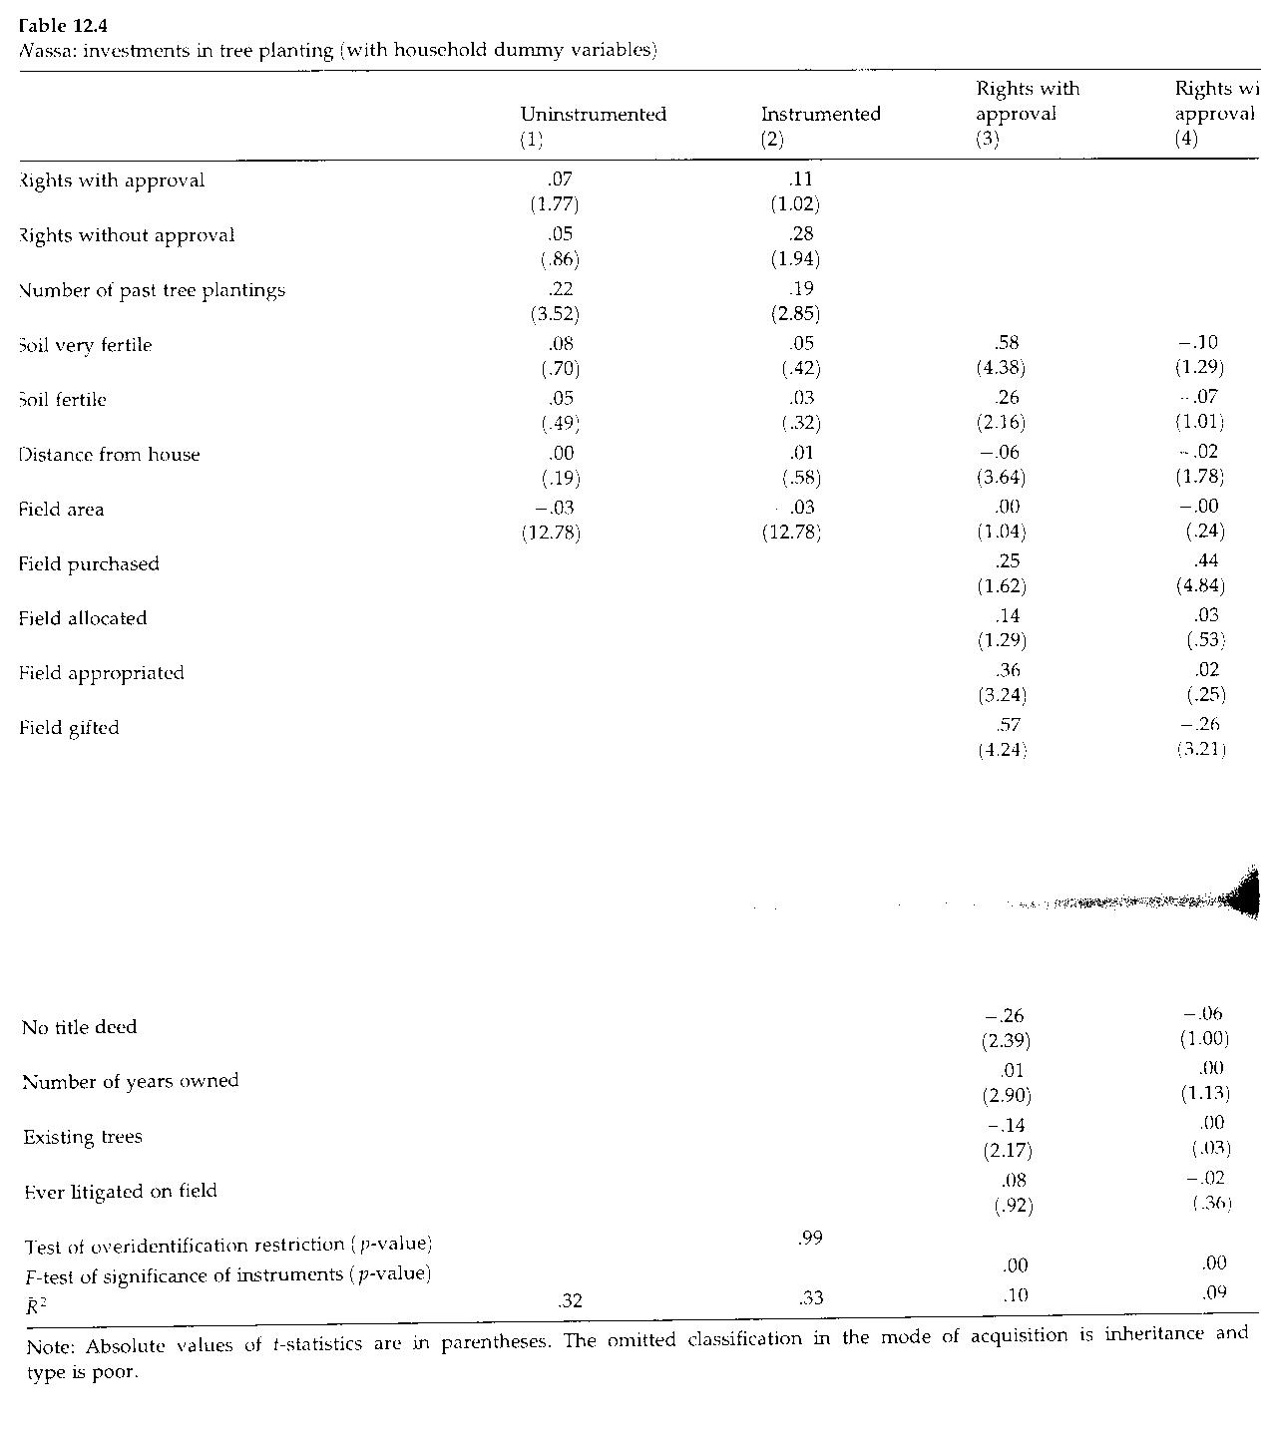

Slide 10
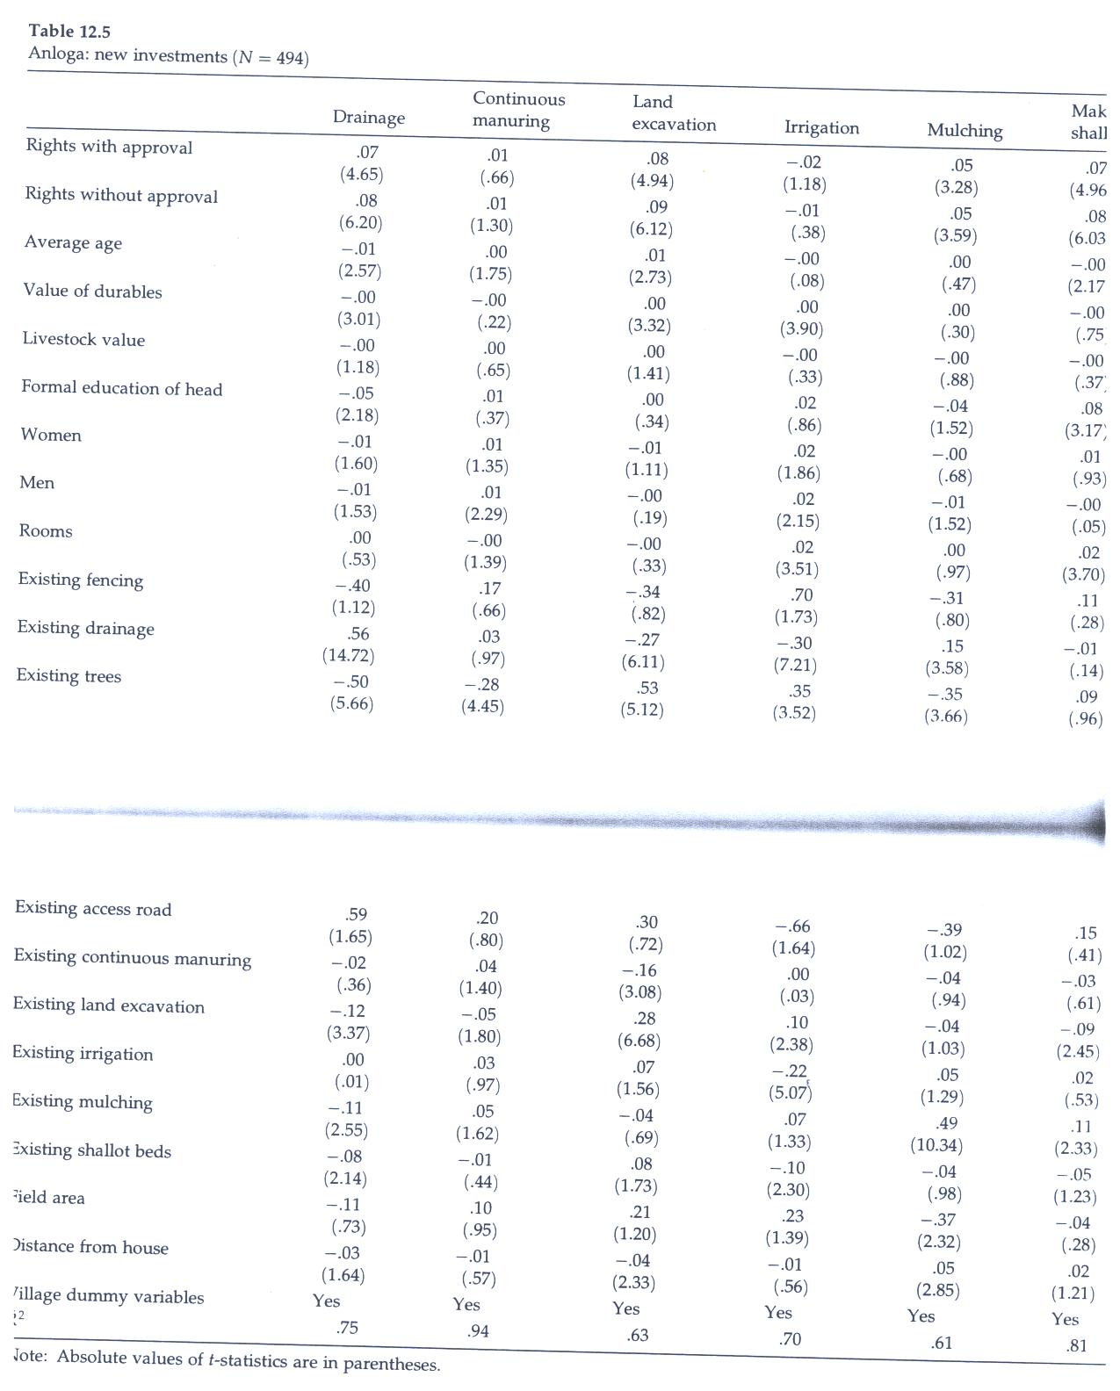

Slide 11
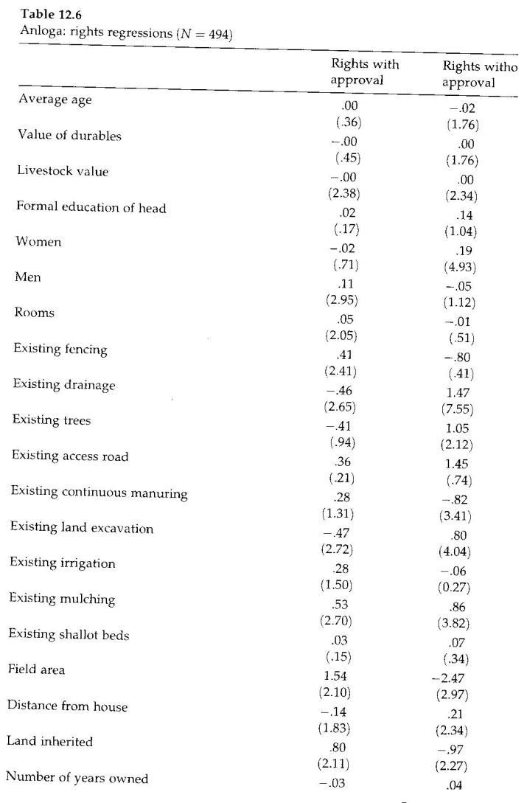

Slide 12
Results of Tables 12.3-6 Summarized
Tables 12.3 and 12.4 show that the land rights have positive and significant effects on tree planting in Wassa that are rather robust to estimation procedure with the results even stronger when instrumented
12.5 and 12.6 for Anloga show positive and significant effects of rights on almost all investments. Improvements at time of acquisition also have significant effects mainly positive on the probability of investment

Slide 13
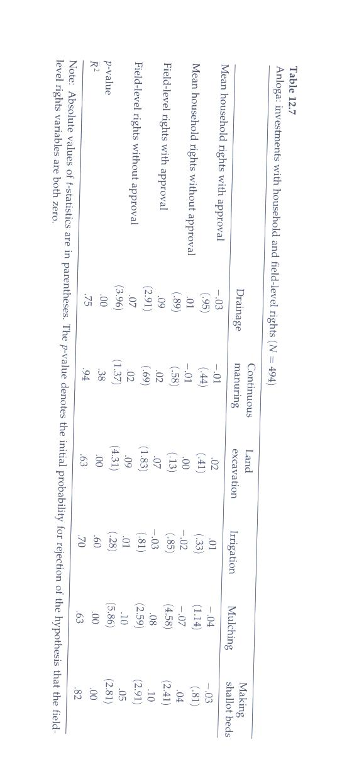

Slide 14
Results from Table 12.7
In 12.7 he distinguishes between credit link which is hh based and the gains from trade link which is field level based. Only the effects of the rights variables are reported in this table
Field level rights and especially those without need for approval have significant positive effects on most investment decisions in Anloga

Slide 15
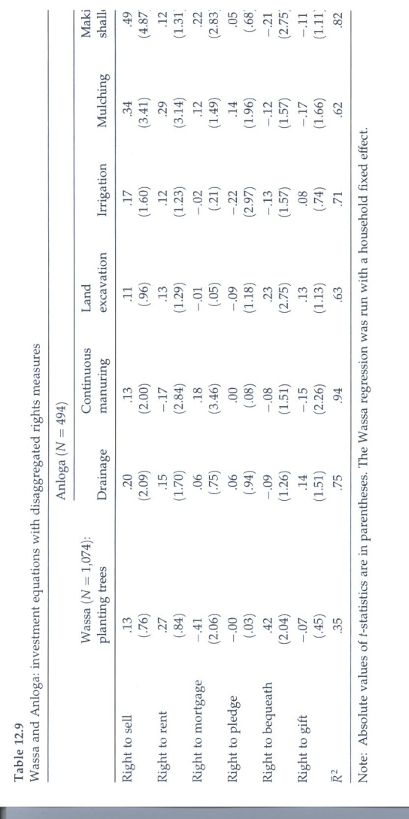

Slide 16
Table 12.9
Re-estimates investment equations for both Wassa and Anloga using all six rights measures
As shown in Table 12. 8, however, some of the individual rights are highly correlated in Anloga but much less so in Wassa
In both cases, some of the rights have significant influences differing across the investments and from one right to another. But overall patterns less clear than with aggregate rights measures of property rights. The latter may be better proxies for confidence of the owner in the rights and titles
No clear evidence in favor of the gains from trade approach over credit link but some doubt on the latter

Slide 17
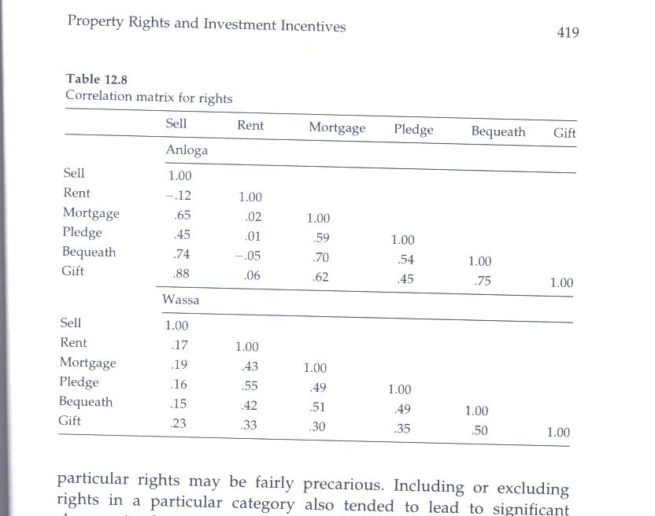

Slide 18
Conclusions
Three links provided at theoretical level
Security
Collateral – credit
Gains from trade (transfer rights)
Strong results for Wassa, weaker for Anloga, in large part because of endogeneity
Larger IV than OLS effects suggest effects of measurement error in index of rights
Clues provided about determinants of rights useful in IVs

